Slide 1
Doc 4.2(10) - WMO Position on the World Radiocommunication Conference 2023 (WRC-23) Agenda
The 19th World Meteorological Congress
Albert Fischer Director, WIGOS Branch 24 May 2023

Slide 2
Introduction
Access to radiofrequency spectrum is critical to the operation of global meteorological and hydrological infrastructure, underpinning the service delivery of all WMO Members.
Satellites, weather radars, radiosondes, hydrological observing systems and drifting buoys all require radio or microwave transmissions to operate.
In particular, microwave observations of the atmosphere from satellites, operating in all weather conditions and providing global coverage several times per day, have been integral to the improved accuracy of forecasts and the extended warning times for severe events that we have available to us today.
Radiofrequency spectrum is a physically limited and increasingly contested resource, with emerging technologies further raising demand, meteorological users of the spectrum must be vigilant and address evolving issues concerning sharing of the spectrum with other radiocommunication services.
 | 2

Slide 3
Background
The WMO Position on the WRC-23 agenda was developed by the SC-ON Expert Team on Radio Frequency Coordination (ET-RFC) to assist National Meteorological and Hydrological Services in their coordination with their National Radiocommunication Regulators and to ensure that the importance of the issues to be discussed at WRC-23 (Dubai, UAE, 20 November – 15 December 2023) is well understood.
The WMO Position was finalized by ET-RFC based on the WRC-23 Conference Preparatory Meeting (27 March – 6 April 2023), providing more specific positions on each agenda item of WRC-23 of prime interest or concern for WMO Members. It identifies specific methods and approaches proposed in the Conference Preparatory Meeting (CPM) report that are aligned with WMO objectives.
 | 3

Slide 4
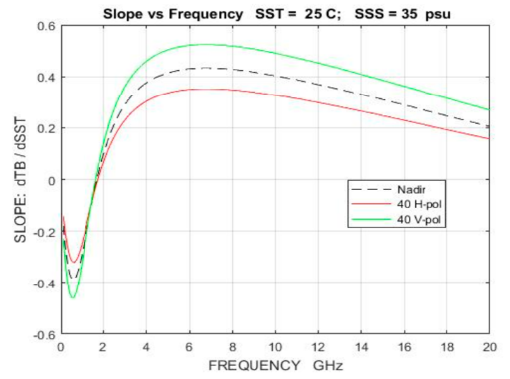
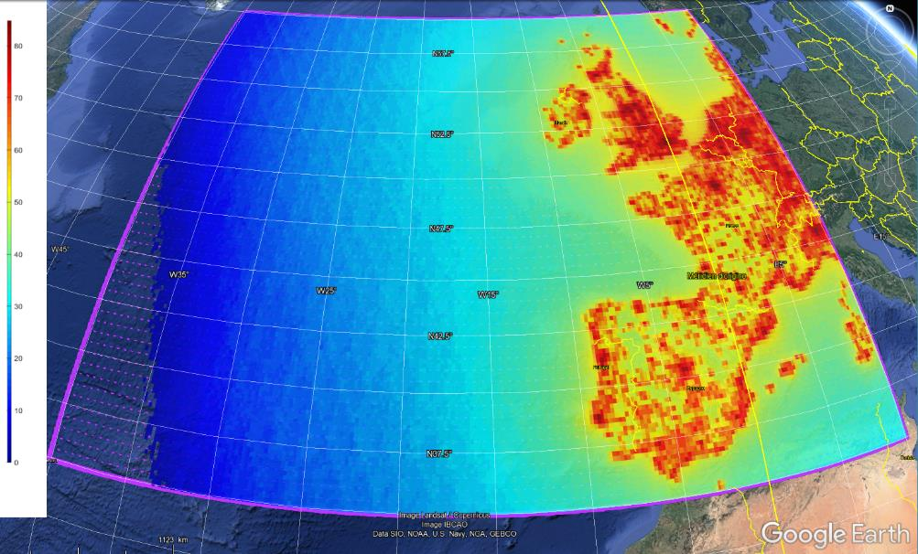
Continuity of SST measurements (A.I. 1.2)
WRC-23 Agenda Item 1.2:
“To consider identification of the frequency bands ... 6425 – 7025 MHz, 7025–7125 MHz ... for International Mobile Telecommunications (IMT), ...”
WMO proposes the following actions to be taken at WRC-23:
To consider NEW primary EESS (passive) allocations in the 4.2-4.4 GHz and 8.4-8.5 GHz frequency bands in which SST measurements can also be performed (to compliment the foreseen degraded SST measurements in 6 425-7 125 MHz)
These possible new primary EESS (passive) allocations do not require protection from existing services but will be able to require protection from potential future new services in these frequency bands
A formal WMO contribution to WRC-23, which will propose these new allocations
* Footnote RR No 5.458 indicates that Administrations should bear in mind the needs of the EESS (passive) ... in their future planning of the bands 6 425-7 075 MHz and 7 075-7 250 MHz
 | Measurements of SST are most efficient when made in the 4-9 GHz range (peak sensitivity to SST occurs in 6/7 GHz *)
 | Studies show that IMT identification will interfere with SST measurements in locations up to 2 000 km from the coast, rendering the data to be degraded
 | 4

Slide 5
Recognition of Space Weather (A.I. 9.1a)
WRC-23 Agenda Item 9.1 topic a):
“... appropriate recognition and protection in the Radio Regulations for space weather sensors, without placing additional constraints on incumbent services”
Currently space weather observations that use the radio spectrum do not have any regulatory protection in the ITU Radio Regulations (RR).
WMO proposes the following two-step approach to be taken at WRC-23:
Define space weather in the context of the Radio Regulations (modification to RR Article 1) and associate space weather with the appropriate “radiocommunication service” under which space weather should be considered (modification to RR Article 4), using the definition and provision provided in the CPM Report:
1.XXX space weather: natural phenomena, mainly originating from solar activity and occurring beyond the major portion of the Earth’s atmosphere, that impact Earth’s environment and human activities
4.XXX Space weather sensors systems may operate under the meteorological aids service (space weather) allocations
Develop a new WRC-27 agenda item on space weather, identifying frequency bands used by space weather sensors/stations that are required protection while not placing undue constraints on incumbent services
A formal WMO contribution to WRC-23, which will elaborate on the frequency ranges to be studied in the framework of a potential new WRC-27 agenda item
 | 5
 | 5

Slide 6
Draft Resolution 4.2(10)/1 (Cg-19)
The WORLD METEOROLOGICAL CONGRESS,
Having considered:
Recommendation 3.2(16)/1 (EC-76) - WMO Position on the WRC-23 Agenda,
The Recommendation by the President of WMO on the adoption of the updated WMO Position on the WRC-23 Agenda,
Adopts the WMO Position on the WRC-23 agenda as contained in the annex to the present Resolution, ...
Requests the Infrastructure Commission to pursue the continuous review of regulatory and technical matters related to radio frequencies for operational and research meteorological and related environmental activities, ...
Requests regional associations (RAs) to coordinate contributions of relevant experts to the work of relevant regional telecommunication organizations and of ITU-R, ...
 | 6

Slide 7
Draft Resolution 4.2(10)/1 (Cg-19)
The WORLD METEOROLOGICAL CONGRESS:
Urges all Members to promote the WMO positions on the relevant WRC-23 agenda items to ensure the availability and protection of suitable radio-frequency bands required for meteorological and related environmental operations and research, ...
Requests the Secretary-General:
To bring the present Resolution to the attention of all concerned, including the International Telecommunication Union;
To pursue as a matter of high priority the coordination role of the Secretariat in radio-frequency matters, ...;
To support the engagement between NMHS and their national radiocommunication administrations, ...;
To assist the Infrastructure Commission in the implementation of the present Resolution.
 | 7

Slide 8
Thank you
^{wmo.int}

